Slide 1


Winter 2023-2024
FLOOR HOCKEY &
FLOORBALL
Nov. 8, 2023
Notes:
RECORD
Link to SLIDES
Link to QUESTzIONS
Roles:
· Chelsea will start the meeting
o My Zoom Account:
§ greid@specialolympicspa.org
§ Buddy0811!
Heather will be on to cover the Regionalization slide. Jenis covering Sport and Training. Andrew Cader will do special events.

Slide 2

Today’s Agenda
Pre-Season Reminders
Floor Hockey & Floorball updated
Athlete Performance Training
Coach – Season Planning
2024 State Competitions
Questions
Notes:
Mike

Slide 3
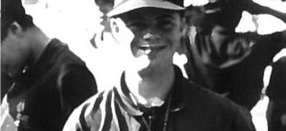
PRE-SEASON
REMINDERS
Notes:
RECORD
Link to SLIDES
Link to QUESTzIONS
Roles:
· Chelsea will start the meeting
o My Zoom Account:
§ greid@specialolympicspa.org
§ Buddy0811!
Heather will be on to cover the Regionalization slide. Jenis covering Sport and Training. Andrew Cader will do special events.

Slide 4
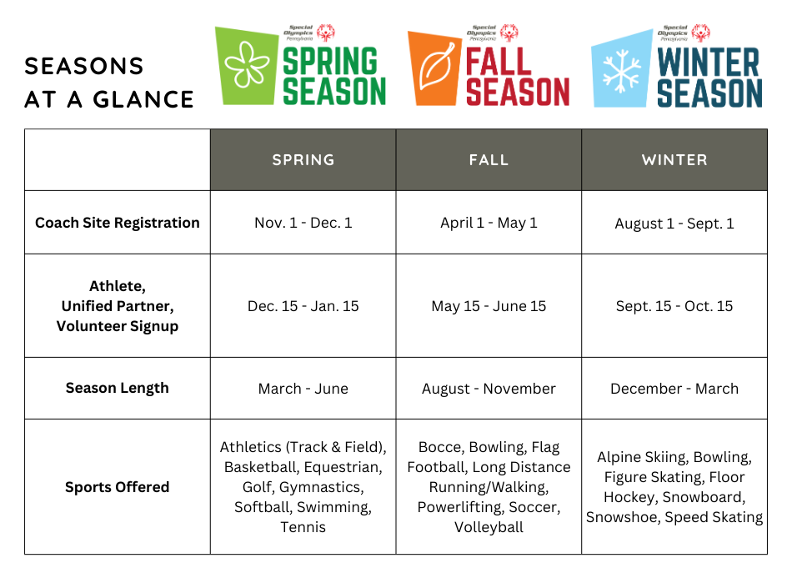
Access Sign Ups on the
SOPA website:
https://specialolympicspa.org/get-involved/sports-sign-ups

Slide 5
Sports Season Prep
Important Winter Dates:
Winter Season Calendar
December 18 – Key Deadline:
Season Dates: December to March
Winter Season Eligibility - all athletes must have current medical on file to be eligible for competition
Age Exemption Request – complete form, update Team Roster on Competition tab and complete Team Rating Form

Slide 6
Athlete Training Requirement
Indoor Winter Games: 10 weeks out is December 22nd; knowing you will break for the holidays trainings should be set to begin no later than early to mid December
Coaches should begin training at least 10 weeks prior to the state culminating event.
Athletes must be trained according to the minimum standards acceptable, for at least eight (8) weeks in the appropriate sport, and must have several opportunities to compete during that period.

Slide 7
Athlete & Volunteer Eligibility
Athlete Requirements: Medical on file WITH signature + expiration dates
Local Programs: Athlete Medical under Certifications
Regions: Athlete Registration Form & Health History under Certifications
Valid for 3 years.
Save attachments under "Attachments" within a person's profile vs. anywhere else in the profile.
Class A Volunteer Requirements: Class A Trainings + Background Check on file
Background Results under Background Checks, Valid for 5 years.
General Orientation under Training, Valid for life.
Protective Behaviors, under Training, Valid for 3 years.
Concussion Training, under Training, Valid for 3 years.
Notes:
What

Slide 8
Unified Partners Eligibility
NEW in 2023 – Unified Sports Partners do not need an athlete medicals.
All Partners – Must have a VSys database record
Ages 16 and up – must have General Orientation and Protective Behaviors Training
Ages 18 and up - Must have General Orientation, Protective Behaviors and a Background check.

Slide 9
UCS: PIAA Medical
A Unified Champion School athlete or Unified Partner may participate in a local program with their PIAA Medical. The participant must request a copy of the medical from their school.
The PIAA physical exam must be inputted into Vsys as an "athlete medical" and the medical form must be uploaded as an attachment.
UPDATE: The PIAA physical exam form is good for one year from the Dr's Signature date. If the date is 3/22/22 the exam expires on 3/22/23.
Notes:
What

Slide 10
Attendance Tracker Updates
Age Calculator – Winter is determined as of 10/15/2023
Eligibility Tab: Deadline for all rostered individual to be eligible is 12/18/2023
  Athlete Medical
  Volunteer: Background Check, Gen Orientation, Protective Behavior, Concussion Training
Sport Specific Rosters/Tabs:
  Team Sports MUST complete Competition tab indicating team each athlete is on or skills
  Team Rating Forms, must be completed by Dec 18 if submitting age exemptions OR by registration for the first competition
Missing volunteer/athlete
  Did they complete Sport Sign-up Form?
    If Yes and you don’t see them contact RSD
ADDITIONAL QUESTIONS?
CONTACT YOUR REGIONAL SPORT DIRECTOR

Slide 11
Attendance
Trackers
Coach will receive tracker when they submit Site Registration Form
Site Attendance Tracker has 4-5 tabs: Directions, Attendance, Eligibility, Competition, Rating Form
Tab 1: Directions: How to complete the form
Tab 2 Attendance:
  Lists all participants that have signed up
  Includes phone, email, DOB and age
  Attendance should be tracked after each practice
  Interest in attending Sectionals & State Games will be used to advance for competitions
  Data will be used to collect training numbers and ultimately future allocations
Notes:
Drop in notes
Attendance Trackers are VERY important. They are accessible to Coach and SOPA so we can quickly and easily address questions Concerns
After a Site Registration form is submitted SOPA will create a roster and it will be shared via email with the coach. There are 3 tabs on each tracker: Directions, Attendance and Eligibility. The direction tab provides a quick overview on how to complete the form. The Attendance tab contains lots of helpful information: the top you will find site information and a tracker that will indicate the number of athletes, volunteers, and certified coaches. With the new sign up process, volunteers and athletes need to sign up for the site. Once they sign up, SOPA will add them to the roster - coaches should not be adding participants. When added coaches will have access to phone numbers and email addresses for all participants and should reach out to share site information to include location, start time and items needed to participate. Once the season starts coaches are expected to be keeping track of attendance. There are yellow boxes and you should insert the date and indicate who is attending. This tab will also be used later in the season to identify people that are interested in attending Sectionals and State Games. If participants complete in local competitions that should be marked. In addition to tracking attendance this form will be used to create training numbers which will result in future allocations for your program. SO...properly completing the form is VERY important. The third tab Eligibility will list all of the participants and will indicate whether their eligibility requirements are up to date. It is critical that athletes and volunteers are current PRIOR to the season starting. If they are out of date or missing they will be highlighted RED. If they will expire prior to state level competition they will be highlighted YELLOW. SOPA will update this tab on a weekly basis. Let's take a look at a tracker.
Local programs will no longer need to complete VSys rosters. VSys rosters will be This is where Vsys rosters are pulled from

Slide 12
Attendance Trackers
Tab 3: Eligibility – If participant is NOT eligible...they cannot participate
  Athletes: Must have current medical
  Volunteer: General Orientation, Concussion Protocol, Protective Behaviors, 18 and over current background check
  Highlighted RED out of date
  Highlighted YELLOW will expire prior to state competition
  Updated weekly by SOPA from November 5 – December 18
  Athletes and Volunteer CANNOT participate in trainings if they have not met all eligibility requirements - it is YOUR responsibility to track this.
  IMPORTANT: Winter Deadline – December 18, 2023
Tab 4: Competition – sport specific
  Required for Team Sports – identifies team participation or skills for each athlete and coach
Tab 5: Rating Form Tab (Floor Hockey/Floorball)
  Required to be completed by Dec 18 if submitting Age Exemption OR by registration date for first competition
Notes:
Drop in notes
Attendance Trackers are VERY important. They are accessible to Coach and SOPA so we can quickly and easily address questions Concerns
After a Site Registration form is submitted SOPA will create a roster and it will be shared via email with the coach. There are 3 tabs on each tracker: Directions, Attendance and Eligibility. The direction tab provides a quick overview on how to complete the form. The Attendance tab contains lots of helpful information: the top you will find site information and a tracker that will indicate the number of athletes, volunteers, and certified coaches. With the new sign up process, volunteers and athletes need to sign up for the site. Once they sign up, SOPA will add them to the roster - coaches should not be adding participants. When added coaches will have access to phone numbers and email addresses for all participants and should reach out to share site information to include location, start time and items needed to participate. Once the season starts coaches are expected to be keeping track of attendance. There are yellow boxes and you should insert the date and indicate who is attending. This tab will also be used later in the season to identify people that are interested in attending Sectionals and State Games. If participants complete in local competitions that should be marked. In addition to tracking attendance this form will be used to create training numbers which will result in future allocations for your program. SO...properly completing the form is VERY important. The third tab Eligibility will list all of the participants and will indicate whether their eligibility requirements are up to date. It is critical that athletes and volunteers are current PRIOR to the season starting. If they are out of date or missing they will be highlighted RED. If they will expire prior to state level competition they will be highlighted YELLOW. SOPA will update this tab on a weekly basis. Let's take a look at a tracker.
Local programs will no longer need to complete VSys rosters. VSys rosters will be This is where Vsys rosters are pulled from

Slide 13
Team Sport
Age Groups
SOPA sponsored Team Sports include:
Fall Season: soccer, flag football, volleyball;
Winter Season: floor hockey;
Spring Season: softball, basketball
UPDATE: Age groups for 22-40 and 40+ will be combined into one 22+ group.
Team Sport Age Group Resource outlines the guidelines.
This document includes links to two supporting documents: Why Age Groups are Important and Exemption Process.
Please review all documents for a full understanding of the age groups and how to submit exemptions. This video will explain these documents and how to submit exemption in more detail.
If you have questions, please contact your Regional Sport Director or Michelle Boone (mboone@specialolympicspa.org).
Notes:
Mike

Slide 14
Qualifiers
All Floor Hockey/Floorball teams and Individual Skills will be eligible to participate in 2024 Indoor Winter Games
We highly encourage scheduling competitions throughout the season with neighboring programs or attending an Invitational
  If your program plans to host an invitational or if you are interested in setting up competitions during the season please drop your interest and info into the chat

Slide 15
Everyone Plays
Everybody on the roster must play in each game and preliminary's
At events:
Teams must complete line-up cards, with numbers and names.
Bottom of the card – those who are not playing and why
Scorekeepers will check the players as they enter the game
Code of conduct will be filed on the coach if all players are not played

Slide 16
SOPA Code of Conduct
All athletes and volunteers are expected to read, sign and follow the SOPA Code of Conduct.
Coaches should review SOPA Code of Conduct during the first practice as a reminder for everyone during the season
As a coach it is your responsibility to promote good sportsmanship. It is also important to know when to give an athlete a break if a situation is escalating.

Slide 17
Medication Reminders - All events
FORMS: Medication Assistance Best Practices, Winter 2023/24 Consent Form and Tracker - forms are located on SOPA website: https://specialolympicspa.org/get-involved/resource-library
Coaches should be sharing this information with athletes, parents/guardians prior to all full day or overnight events. SOPA will no longer be emailing this information to all participants.
Please ensure your athletes are completing the Medication Assistance Consent Form and your Class A volunteers traveling with the delegation are completing the Medication Assistance Tracker.
Please reach out to chammell@specialolympicspa.org directly with any questions or concerns on the process.
Notes:
What

Slide 18
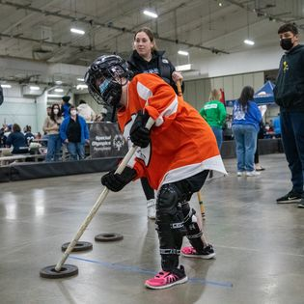
FLOOR HOCKEY &
FLOORBALL
UPDATES
Notes:
RECORD
Link to SLIDES
Link to QUESTzIONS
Roles:
· Chelsea will start the meeting
o My Zoom Account:
§ greid@specialolympicspa.org
§ Buddy0811!
Heather will be on to cover the Regionalization slide. Jenis covering Sport and Training. Andrew Cader will do special events.

Slide 19
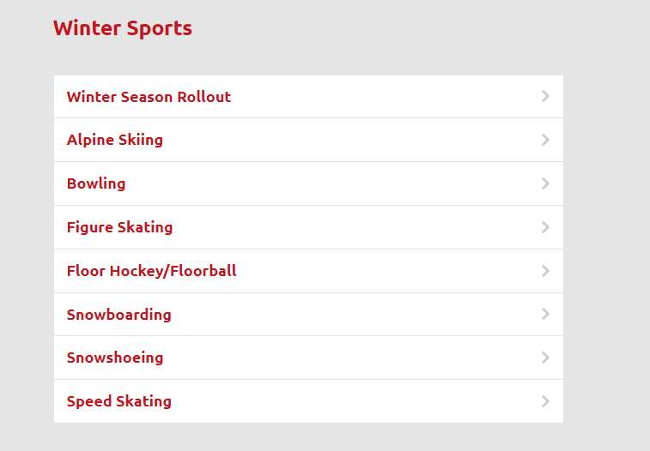
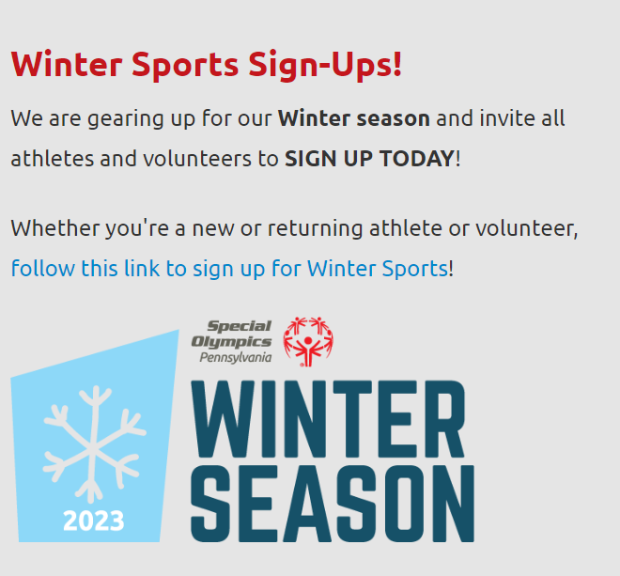
SOPA Website - Sports Offered Page
Links to all the sport pages
Sports Offered
Seasonal Sign-up
Lots of great resources!

Slide 20

Sport Management Team (SMT)
  Maryellen Brown – snickersbrown5@gmail.com
  Jennifer Tresp – jtresp@specialolympicspa.org
  Purpose of SMT is to determine future direction of the sport, plan/execute competitions and train coaches and officials.
  We are looking for 1 representative from each Region to form this team. If you are interested, please contact Jennifer Tresp.

Slide 21
Floor Hockey/Floorball
  2024 State Competition offerings (both Floor Hockey and Floorball):
  Individual Skills
  Team play will be available for 16-21 and 22+ at Indoor Winter Games
  Officials needed
  If you know anyone interested, please share their contact information with Jennifer Tresp.
  Sport Transition
  Definitive plan to transition Floor Hockey to Floorball will be determined following this season, as we pilot Floorball.

Slide 22
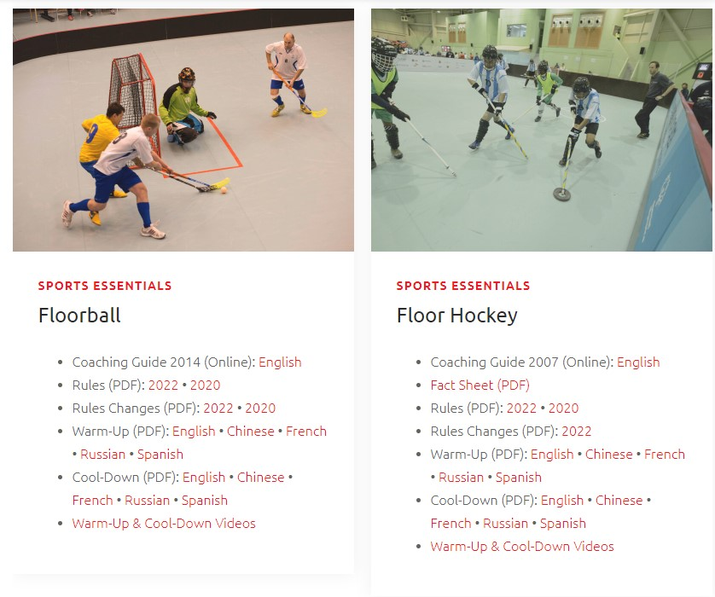
SOI Sport Rules & Resources
Special Olympics Resources
Coaching Guide​ (2007)
Fact Sheet​
Rules (2022)​
Rule Changes (2022)​
Warm Up and Cool Down Guides
Direct Links:
Floorball Resources & Floor Hockey Resources
​

Slide 23
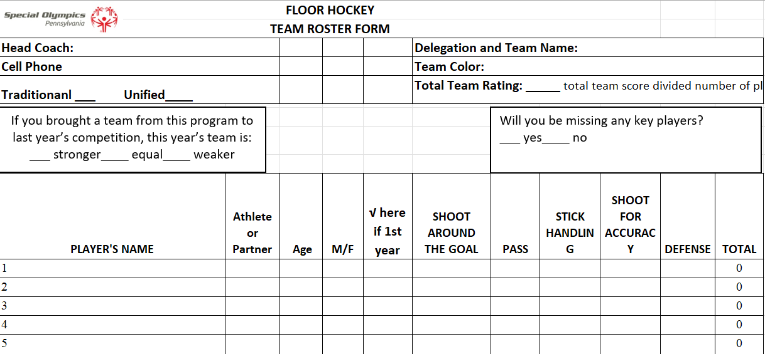
Floor Hockey Team Assessment Form
This form is the team assessment form we are using for IWG
Will be added to attendance tracker
Notes:
Mike
Pass to Bruce

Slide 24
Floor Hockey Equipment
All players must wear the following Mandatory Protective Equipment: ​
​
Helmets with full face masks ​
  Check helmets for secure padding as well as fit​
Gloves (i.e., padded gloves, street hockey gloves, field hockey gloves) ​
Shin Guards (street hockey, ice hockey, soccer guards) the goalkeeper will be allowed to wear regulation size ice hockey goalkeeper pads not to exceed 31 centimeter (12 in) in width. ​
Proper athletic footwear (i.e. running shoes) ​
It is advisable that players wear the following Recommended Protective Equipment:
        Elbow pads, Athletic supporter, Knee pads, Goalie chest protector, & Mouthpiece
Prior to each game the referees will check for proper equipment.

Slide 25
Floor Hockey Rules
Updates/Reminders
If the puck hits the referee and goes directly into the goal, the goal is disallowed.
Games will consist of three 9-minute periods, with a 1-minute break between each period.
The last three minutes of the third period (the 9th line) shall be stop time unless waived by both coaches prior to the start of the line.
One 1-minute time-out is allowed per team per game. Coaches will signal their desire for a time-out to the referee by making a "T" sign with their hands.
A time out will only be granted at a stoppage of play.

Slide 26
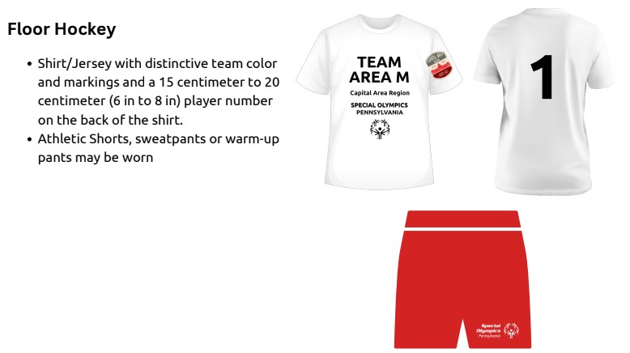
Floor Hockey Uniform

Slide 27
Floor Hockey Uniform -
Protective Equipment
  All players must wear the following Mandatory Protective Equipment:
  Helmets with full face masks
  Gloves (i.e., padded gloves, street hockey gloves, field hockey gloves)
  Shin Guards (street hockey, ice hockey, soccer guards)
  Goalkeeper will be allowed to wear regulation size ice hockey goalkeeper pads not to exceed 31 centimeter (12 in) in width.
  Proper athletic footwear (i.e., running shoes)
  It is advisable that players wear the following Recommended Protective Equipment:
  Elbow pads & knee pads
  Athletic supporter
  Goalie chest protector
  Mouthpiece

Slide 28
Floorball
  Coach Training
  Held a Coach Training in October, 22 coaches and 2 officials attended.
        There was a lot of interest from coaches to start teams coming out of the training.
  Plan for 2023-24
  4 counties, potentially more are planning to start teams for this season.
  Floorball team (16-21 and 22+) will be offered at Indoor Winter Games.
  Floorball skills will also be offered at Indoor Winter Games.
  Floorball skills will be set-up during Olympic Village, OC/Dance for all athletes to give it a try
  You can find more information, equipment and resources: https://www.floorballplanet.com/
  Interested or have questions? Contact Michelle Boone at mboone@specialolympicspa.org

Slide 29
Floorball Game and Equipment
SOPA will play a 5v5 format
Within the SOI Rules this falls under Unified Team Competition (Section 6, page 21-29)
This will allow us to keep the same format and same sized field/goals for both Unified and Traditional teams
Roster size: minimum 8, maximum 10 (Unified maximum 12) - suggested at least 8 field players and 2 goalies.
Periods: Two (2) - 15-minute periods will be played with a 5-minute halftime
Running clock except for goals, penalties and injuries
Individual Skills are outlined in the SOI Rule Book (Section 8, pages 43-45), similar to Floor Hockey
  5 skills: Shoot Around Goal, Receiving and Passing, Stickhandling, Shoot for Accuracy, Flip Pass over an Obstacle
  A scoresheet will be developed and included on the Sports Offered page
Required Field Player Equipment:​
  Stick (straight or curved, different lengths based on player height)

Slide 30
Floorball Uniform and Goalie
Uniform:
Jersey – number front (small) and back (large), numbers 2-99
Shorts (long pants/tights are not allowed)
Knee high socks
Sneakers
Goalkeeper
Jersey – number front (small) and back (large), numbers 1-99
Long Trousers over pads
Does NOT use a stick
Must wear IFF approved face mask
Protective equipment
Thin gloves allowed

Slide 31
Brand and Uniform Guidelines
New Resource that include SO brand and uniform guidelines
Includes mock-ups of sport specific uniforms
SOPA Brand and Uniform Guidelines

Slide 32
Athlete Performance Training
Snapshot
Interested Coaches
Learn More by visiting the APT webpage
How to sign-up
FREE to programs/teams
Provide health, fitness and wellness education to athletes and coaches
Benefits of APT
Go to your VSys portal and complete the Athlete Performance Training under "Training Schools, Webinars and More"
Watch the video, take the quiz and then complete the registration form
HQ will provide coaches and atheltes with materials
Turn-key, easy to execute
Participation qualifies coaches for Bronze level certification
Notes:
What

Slide 33

Notes:
Michelle

Slide 34
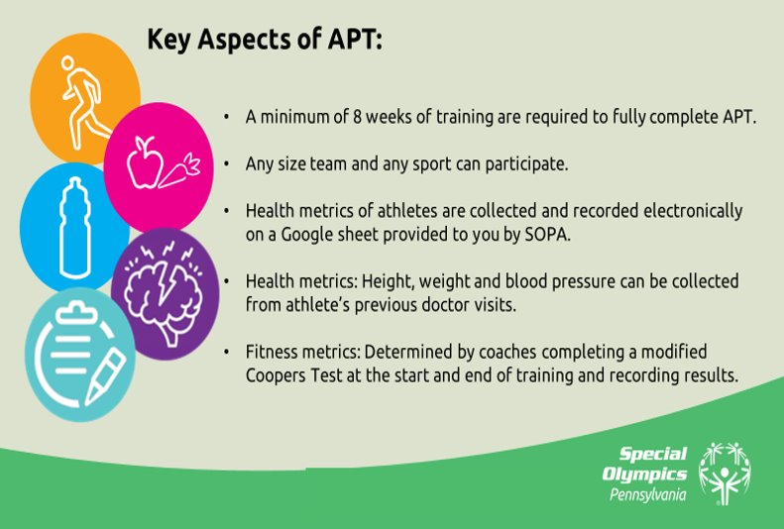
Notes:
Michelle

Slide 35

Notes:
Michelle

Slide 36

Notes:
Michelle

Slide 37

Notes:
Michelle

Slide 38
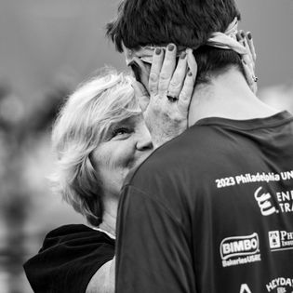
COACH –
SEASON PLANNING
Notes:
RECORD
Link to SLIDES
Link to QUESTzIONS
Roles:
· Chelsea will start the meeting
o My Zoom Account:
§ greid@specialolympicspa.org
§ Buddy0811!
Heather will be on to cover the Regionalization slide. Jenis covering Sport and Training. Andrew Cader will do special events.

Slide 39
Be Prepared for the Season!
Get everyone eligible
Keep a pulse on illness/disease outbreaks within your community – remind athletes not to attend training if they are sick and to practice healthy habits and good hygiene.
Know your facilities Emergency Action Plan and Evacuation route
Updated yourself on sport rules and work with assistant coaches on a seasonal plan – identify who will manage each task during practice. Recruit additional assistance if needed.
Notes:
Michelle

Slide 40
Weekly Training Plans
Elements of a Training Plan
Arrival
Warm-up
Skills
Competition situations
Cool Downs
Athlete Performance Training (APT)
Water Breaks
Notes:
Michelle

Slide 41
Arrival & Warm-up
Arrival
Coach - Greets the athlete and starts them on their warm-up
Warm-up - 10 - 15 minutes
Exercises that get the heart pumping
  Jog in place, Jumping Jacks, High Knees, arm circles
Warm- up each part of the body
SOI Dynamic Warm-Up Guide
Notes:
Michelle

Slide 42
Skills & Competition Situations
Skills (20-30 minutes)
This part will be the bulk of your training.
Switch it up, run drill stations so everyone is moving as much as possible and not waiting in lines.
Focus on the basics and fundamentals of the sport, repetition is key!
Competition Situations (10-20 minutes)
Game-like situations, scrimmages
Fitness/endurance - get the heart rate up
Notes:
Michelle

Slide 43
Cool Down
Cool Downs - 10 Minutes
2 laps around the field/court/parking lot - walk, speed walk, jog
Exercises that slow the heart down, stretches
Cool Down each part of the body
SOI Cool Down Guide
Conduct Athlete Performance Training lesson of the day
At this time remind athletes:
Next Practice or information on upcoming event
Stretch before bed - Every night (use cool down stretches to build flexibility and prevent injury)
Bring your own water bottle
Notes:
Michelle

Slide 44

Coaching Requirements
As of January 2021, Coach requirements for training and competition:
Team Sports:
  Must have at least one or more certified coach(s) per team
Individual Sports and Team Individual Skills:
  Must have at least one or more certified coach(s) per 25 athletes
Notes:
Michelle

Slide 45

Continuing Education Update
Protective Behavior and Concussion Training has been removed from the list of approved courses for Continuing Education and from the Continuing Education Request form.
Effective February 1, 2023, these two courses will not be accepted for continuing education
There are plenty of Continuing Education options available on the SOPA website.

Slide 46
Coaching Practicum Hours
If a coach needs to complete 10 required practicum hours from sport training courses, that were taken in 2019, 2020, 2021 they have until December 2023 to submit these hours.
Hours must be submitted on their VSys Portal.

Slide 47
Expired Sport Certifications
If your sport certification expired between 2020 and 2022 you have until December of 2023 to complete your continuing education course to update your certifications.
This extension expires on December 31, 2023.
On January 1, 2024, you will need to retake the Sport that has not been updated.

Slide 48
Athlete as Coach
Do you have an athlete who would like to be a coach?
Tuesday, November 14th at 6:00 PM, Jordan and Jennifer will be hosting our Athletes as Coaches webinar for the winter sports season. This is open to any athlete that currently is or is interested in becoming a coach in not just a winter sport, but any sport! To register for that one, please click here: https://us02web.zoom.us/meeting/register/tZUkcu2uqj0rGdHcFJTFL0PuqjntY1qRFkd8
Athlete as Coach Request form to be completed by athletes who wish to apply to be trained as a coach: https://drive.google.com/file/d/1WZC14Ssl1IsilbBO_93WDmsaQq9-wmK3/view
Notes:
Michelle

Slide 49
Floor Hockey Skills Training
At this time we are planning to conduct an in-person coach training in the Lebanon/Berks area to service GLVPR, Region 6 and Captial Area Region.
Date will be emailed out to Regional Sport Directors, this group and listed on the website shortly; aiming for early December.
If you have an additional need please contact Michelle Boone, mboone@specialolympicspa.org
Notes:
Michelle

Slide 50
Volunteer Q & A
What is the minimum age for a Head Coach? 18
What is the youngest age of a Unified Partner? 8
What age do you need a Young athlete chaperone for?
Overnight events for 8 & 9 year olds
Can my assistant coach be 14? Training yes; Events No
1-day events - 16
Overnight events - 18
Notes:
Jennifer

Slide 51
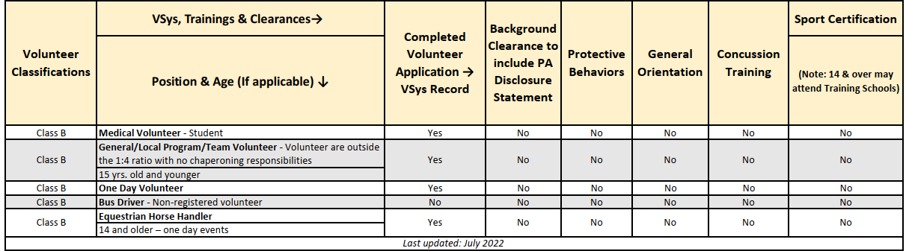
Volunteer Position Requirements
Class B
Notes:
Jennifer

Slide 52
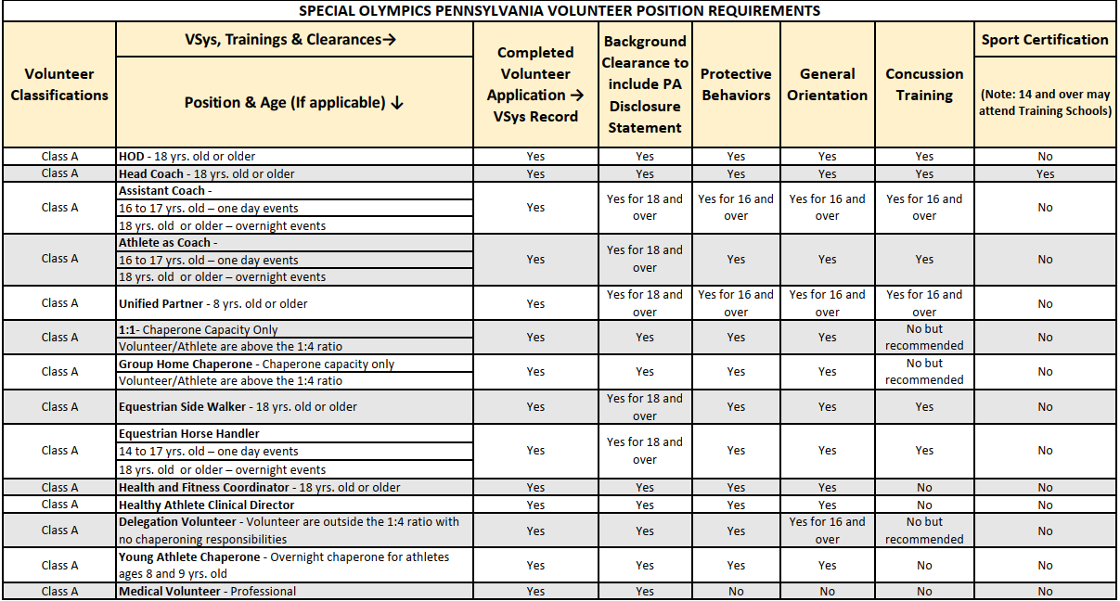
Volunteer Position Requirements
Notes:
Jennifer

Slide 53
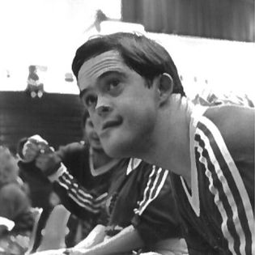
2024
STATE COMPETITIONS
Notes:
RECORD
Link to SLIDES
Link to QUESTzIONS
Roles:
· Chelsea will start the meeting
o My Zoom Account:
§ greid@specialolympicspa.org
§ Buddy0811!
Heather will be on to cover the Regionalization slide. Jenis covering Sport and Training. Andrew Cader will do special events.

Slide 54
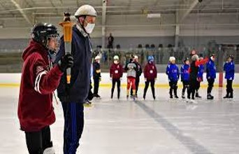
Indoor Winter Games:
March 2-3, 2024
Various Venues throughout York, PA
2024 State Competition & Important Dates
Event Reg Info shared January 12th
LOI due January 25th
Final Allocation sent out January 26th
Online Vsys Roster due January 29th
Registration due February 8th
Competition Eligibility deadline February 21st
Scratch/Activation due February 22nd
Notes:
Mike

Slide 55
Indoor Winter Games – Arrival/Departure
Arrival
Delegation Registration, Saturday, March 2, 9-10 am
Departure
Sunday, March 3, 3:30 pm
Housing
Housing will be available on Saturday evening for all delegations.
Availability for Friday night housing will be based on travel radius; eligible counties will be alerted with Event Registration
Tentative Schedule will be shared 8 weeks prior to Indoor Winter Games with Event Registration Information.
Notes:
Erika

Slide 56

USA Games
2026 USA Games
  June 20-26
  University of Minnesota
  2024 events will be qualifiers for USA Games, SOPA will not be allocated specific slots until late 2024 – floor hockey/floorball has not historically been offered as part of USA Games
Notes:
Erika
As a reminder the 2023 World Games is set for June 16th - 25th in Berlin. We are still awaiting for our final allocations.
The 2026 USA Games was recently announced that it will be held sometime in June at the University of Minnesota. More info to be shared as we receive information.
Thanks now I am going to turn it over to Charla to talk about Athlete Performance Training.

Slide 57
THANK YOU

